Slide 1
Session 5 – Java Server Page

Slide 2
Agenda
Why we need JSP
How JSP works
Benefits of JSP
Setting up your environment for JSP
A simple example
Notes:
Compare with the others
Talk

Slide 3
The Need for JSP
With servlets, it is easy to
  Read form data
  Read HTTP request headers
  Set HTTP status codes and response headers
  Use cookies and session tracking
  Share data among servlets
  Remember data between requests
  Get fun, high-paying jobs
But, it sure is a pain to
  Use those println statements to generate HTML
  Maintain that HTML
Notes:
Talk

Slide 4
The JSP Framework
Idea:
  Use regular HTML for most of page
  Mark servlet code with special tags
  Entire JSP page gets translated into a servlet (once), and servlet is what actually gets invoked (for each request)
Example:
  JSP
    Thanks for ordering
    <I><%= request.getParameter("title") %></I>
  URL
    http://host/OrderConfirmation.jsp
    ?title=Core+Web+Programming
  Result
    Thanks for ordering Core Web Programming
Notes:
Talk

Slide 5
Benefits of JSP
Although JSP technically can't do anything servlets can't do, JSP makes it easier to:
  Write HTML
  Read and maintain the HTML
JSP makes it possible to:
  Use standard HTML tools such as Allaire HomeSite, Macromedia DreamWeaver, or Adobe GoLive.
  Have different members of your team do the HTML layout than do the Java programming
JSP encourages you to
  Separate the (Java) code that creates the content from the (HTML) code that presents it
Notes:
Talk

Slide 6
Advantages of JSP Over Competing Technologies
Versus ASP or ColdFusion
  Better language for dynamic part
  Portable to multiple servers and operating systems
Versus PHP
  Better language for dynamic part
  Better tool support
Versus pure servlets
  More convenient to create HTML
  Can use standard tools (e.g., HomeSite)
  Divide and conquer
  JSP programmers still need to know
  servlet programming
Notes:
ASP: <% %>
PHP: <?php ?>

Slide 7
Advantages of JSP (Continued)
Versus Velocity or WebMacro
  Standard
Versus client-side JavaScript (in browser)
  Capabilities mostly do not overlap with JavaScript, but
    You control server, not client
    Richer language
Versus server-side JavaScript
(eg, LiveWire, BroadVision, JRun)
  Richer language
Versus static HTML
  Dynamic features
  Adding dynamic features no longer
  "all or nothing" decision

Slide 8
Setting Up Your Environment
Set your CLASSPATH. Not.
Compile your code. Not.
Use packages to avoid name conflicts. Not.
Put JSP page in special directory. Not.
  install_dir\webapps\ROOT\ (HTML and JSP -- Tomcat)
  install_dir\servers\default\default-app (JRun)
  Some servers reserve certain parts of Web hierarchy for JSP pages. Tomcat 3 and JRun (standalone) don't.
Use special URL to invoke JSP page. Not.
Caveats
  Previous rules about CLASSPATH, install dirs, etc., still apply to regular Java classes used by a JSP page
Notes:
Just overview

Slide 9
Example
<!DOCTYPE HTML PUBLIC
"-//W3C//DTD HTML 4.0 Transitional//EN">
<HTML>
<HEAD>
<TITLE>JSP Expressions</TITLE>
<META NAME="author" CONTENT="Marty Hall">
<META NAME="keywords"
CONTENT="JSP,expressions,JavaServer,Pages,servlets">
<META NAME="description"
CONTENT="A quick example of JSP expressions.">
<LINK REL=STYLESHEET
HREF="JSP-Styles.css"
TYPE="text/css">
</HEAD>
Notes:
Overview

Slide 10
Example (Continued)
<BODY>
<H2>JSP Expressions</H2>
<UL>
<LI>Current time: <%= new java.util.Date() %>
<LI>Your hostname: <%= request.getRemoteHost() %>
<LI>Your session ID: <%= session.getId() %>
<LI>The <CODE>testParam</CODE> form parameter:
<%= request.getParameter("testParam") %>
</UL>
</BODY>
</HTML>

Slide 11
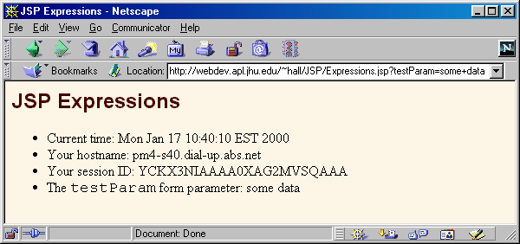
Example Result
If location was
  C:\jakarta-tomcat-4.0\webapps\ROOT\Expressions.jsp or
  C:\Program Files\Allaire\JRun\servers\default\
  default-app\Expressions.jsp
URL would be
  http://localhost/Expressions.jsp

Slide 12
Most Common Misunderstanding
Forgetting JSP is Server-Side Technology
Very common question
  I can’t do such and such with HTML.
  Will JSP let me do it?
Why doesn’t this question make sense?
  JSP runs entirely on server
  It doesn’t change content the client (browser) can handle
Similar questions
  How do I put a normal applet in a JSP page?
  Answer: send an <APPLET…> tag to the client
  How do I put an image in a JSP page?
  Answer: send an <IMG …> tag to the client
  How do I use JavaScript/Acrobat/Shockwave/Etc?
  Answer: send the appropriate HTML tags

Slide 13
2nd Most Common Misunderstanding
Translation/Request Time Confusion
What happens at page translation time?
  JSP constructs get translated into servlet code.
What happens at request time?
  Servlet code gets executed. No interpretation of JSP occurs at request time. The original JSP page is totally ignored at request time; only the servlet that resulted from it is used.
When does page translation occur?
  Typically, the first time JSP page is accessed after it is modified. This should never happen to real user (developers should test all JSP pages they install).
  Page translation does not occur for each request.

Slide 14
The JSP Lifecycle
 | Page first written | Request #1 | Request #2 | Server restarted | Request #3 | Request #4 | Page modified | Request #5 | Request #6
JSP page translated into servlet |  | Yes | No |  | No | No |  | Yes | No
Servlet compiled |  | Yes | No |  | No | No |  | Yes | No
Servlet instantiated and loaded into server's memory |  | Yes | No |  | Yes | No |  | Yes | No
init (or equivalent) called |  | Yes | No |  | Yes | No |  | Yes | No
doGet (or equivalent) called |  | Yes | Yes |  | Yes | Yes |  | Yes | Yes

Slide 15
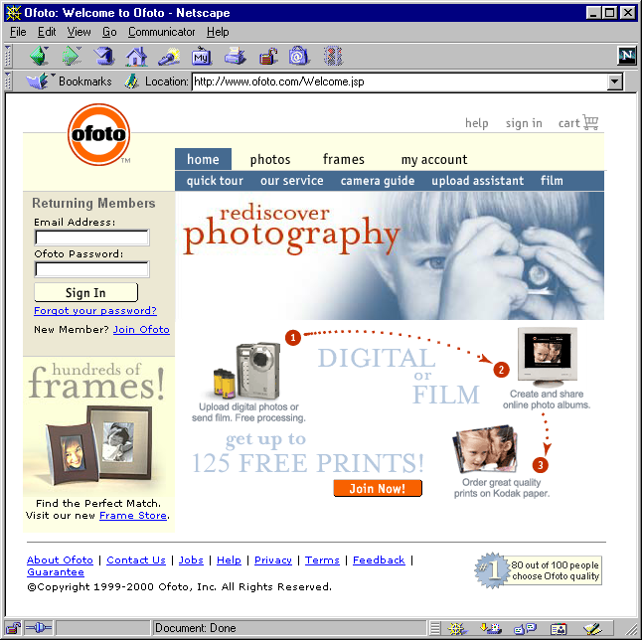
JSP/Servlets in the Real World
ofoto.com:
print and
manage
digital and
conventional
photos.

Slide 16
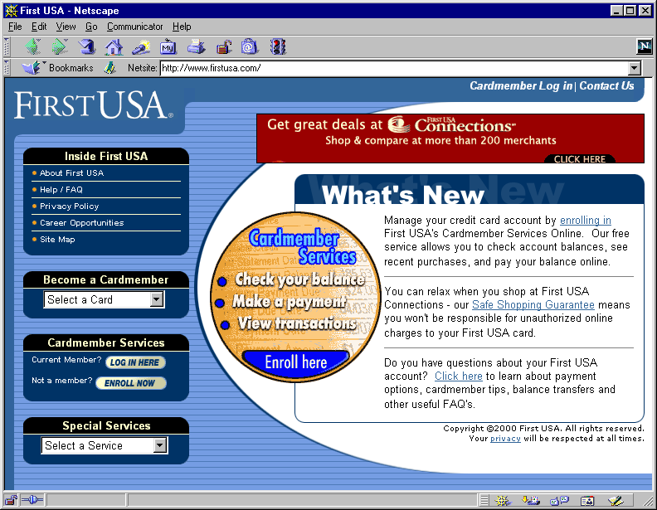
JSP/Servlets in the Real World
First USA Bank: largest credit card issuer in the world; most on-line banking customers

Slide 17
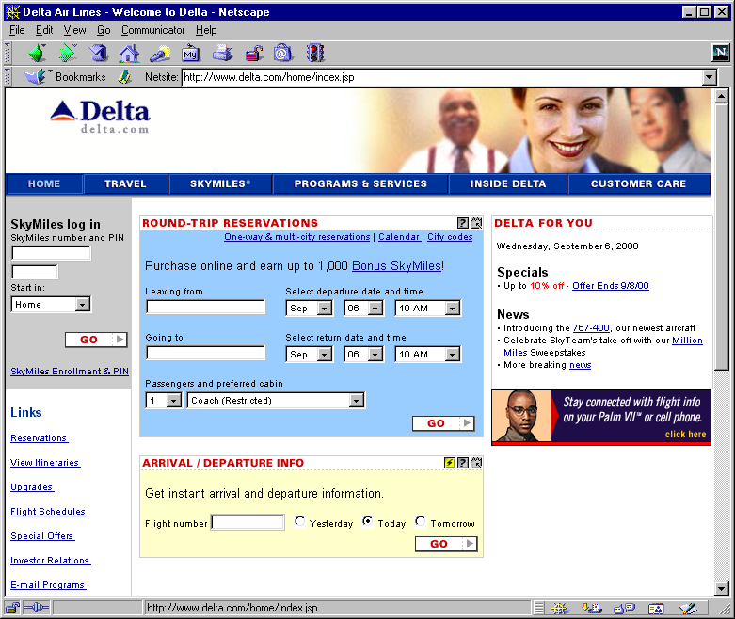
JSP/Servlets in the Real World
Delta Airlines: entire Web site, including real-time schedule info

Slide 18
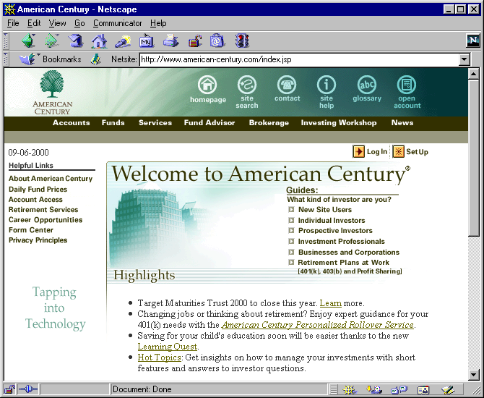
JSP/Servlets in the Real World
American Century Investments: more than 70 mutual funds, $90 billion under management, two million investors

Slide 19
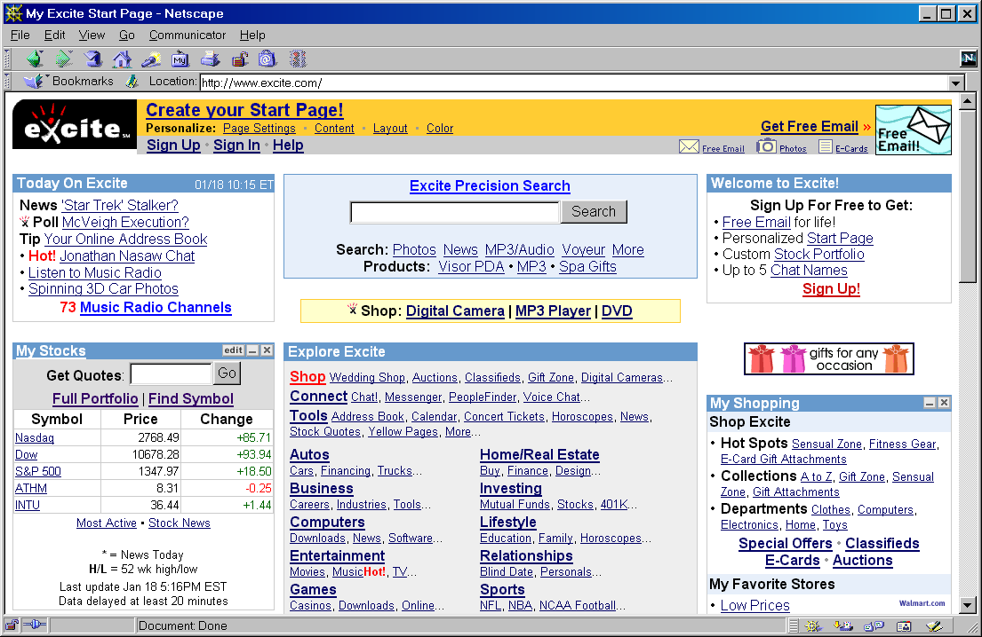
JSP/Servlets in the Real World
Excite: one of the top five Internet portals; one of the ten busiest sites on the Web

Slide 20
Summary
JSP makes it easier to create and maintain HTML, while still providing full access to servlet code
JSP pages get translated into servlets
  It is the servlets that run at request time
  Client does not see anything JSP-related
You still need to understand servlets
  Understanding how JSP really works
  Servlet code called from JSP
  Knowing when servlets are better than JSP
  Mixing servlets and JSP
Other technologies use similar approach, but aren't as portable and don't let you use Java for the "real code"

Slide 21
Agenda - Scripting Elements
Basic syntax
Types of JSP scripting elements
Expressions
Predefined variables
Scriptlets
Declarations

Slide 22
Uses of JSP Constructs
Simple
Application
Scripting elements calling servlet code directly
Scripting elements calling servlet code indirectly (by means of utility classes)
Beans
Custom tags
Servlet/JSP combo (MVC),
with beans and possibly custom tags
Complex
Application

Slide 23
Design Strategy: Limit Java Code in JSP Pages
You have two options
  Put 25 lines of Java code directly in the JSP page
  Put those 25 lines in a separate Java class and put 1 line in the JSP page that invokes it
Why is the second option much better?
  Development. You write the separate class in a Java environment (editor or IDE), not an HTML environment
  Debugging. If you have syntax errors, you see them immediately at compile time. Simple print statements can be seen.
  Testing. You can write a test routine with a loop that does 10,000 tests and reapply it after each change.
  Reuse. You can use the same class from multiple pages.
Notes:
Talk

Slide 24
Basic Syntax
HTML Text
  <H1>Blah</H1>
  Passed through to client. Really turned into servlet code that looks like
    out.print("<H1>Blah</H1>");
HTML Comments
  <!-- Comment -->
  Same as other HTML: passed through to client
JSP Comments
  <%-- Comment --%>
  Not sent to client
To get <% in output, use <\%

Slide 25
Types of Scripting Elements
Expressions
  Format: <%= expression %>
  Evaluated and inserted into the servlet’s output. I.e., results in something like out.print(expression)
Scriptlets
  Format: <% code %>
  Inserted verbatim into the servlet’s _jspService method (called by service)
Declarations
  Format: <%! code %>
  Inserted verbatim into the body of the servlet class, outside of any existing methods
Notes:
Very clear

Slide 26
JSP Expressions
Format
  <%= Java Expression %>
Result
  Expression evaluated, converted to String, and placed into HTML page at the place it occurred in JSP page
  That is, expression placed in _jspService inside out.print
Examples
  Current time: <%= new java.util.Date() %>
  Your hostname: <%= request.getRemoteHost() %>
XML-compatible syntax
  <jsp:expression>Java Expression</jsp:expression>
  XML version not supported by Tomcat 3. Until JSP 1.2, servers are not required to support it. Even then, you cannot mix versions within a single page.
Notes:
Very clear

Slide 27
JSP/Servlet Correspondence
Original JSP
<H1>A Random Number</H1>
<%= Math.random() %>
Possible resulting servlet code
public void _jspService(HttpServletRequest request,
HttpServletResponse response)
throws ServletException, IOException {
response.setContentType("text/html");
HttpSession session = request.getSession(true);
JspWriter out = response.getWriter();
out.println("<H1>A Random Number</H1>");
out.println(Math.random());
...
}

Slide 28
Example Using JSP Expressions
<BODY>
<H2>JSP Expressions</H2>
<UL>
<LI>Current time: <%= new java.util.Date() %>
<LI>Your hostname: <%= request.getRemoteHost() %>
<LI>Your session ID: <%= session.getId() %>
<LI>The <CODE>testParam</CODE> form parameter:
<%= request.getParameter("testParam") %>
</UL>
</BODY>

Slide 29
Predefined Variables
request
  The HttpServletRequest (1st argument to service/doGet)
response
  The HttpServletResponse (2nd arg to service/doGet)
out
  The Writer (a buffered version of type JspWriter) used to send output to the client
session
  The HttpSession associated with the request (unless disabled with the session attribute of the page directive)
application
  The ServletContext (for sharing data) as obtained via getServletContext().

Slide 30
JSP Scriptlets
Format
  <% Java Code %>
Result
  Code is inserted verbatim into servlet's _jspService
Example
  <%
  String queryData = request.getQueryString();
  out.println("Attached GET data: " + queryData);
  %>
  <% response.setContentType("text/plain"); %>
XML-compatible syntax
  <jsp:scriptlet>Java Code</jsp:scriptlet>

Slide 31
JSP/Servlet Correspondence
Original JSP
<%= foo() %>
<% bar(); %>
Possible resulting servlet code
public void _jspService(HttpServletRequest request,
HttpServletResponse response)
throws ServletException, IOException {
response.setContentType("text/html");
HttpSession session = request.getSession(true);
JspWriter out = response.getWriter();
out.println(foo());
bar();
...
}

Slide 32
Example Using JSP Scriptlets
<!DOCTYPE HTML PUBLIC
"-//W3C//DTD HTML 4.0 Transitional//EN">
<HTML>
<HEAD>
<TITLE>Color Testing</TITLE>
</HEAD>
<%
String bgColor = request.getParameter("bgColor");
boolean hasExplicitColor;
if (bgColor != null) {
hasExplicitColor = true;
} else {
hasExplicitColor = false;
bgColor = "WHITE";
}
%>

Slide 33
Example Using JSP Scriptlets (Continued)
<BODY BGCOLOR="<%= bgColor %>">
<H2 ALIGN="CENTER">Color Testing</H2>
<%
if (hasExplicitColor) {
…
} else {
…
}
%>
</BODY>
</HTML>

Slide 34
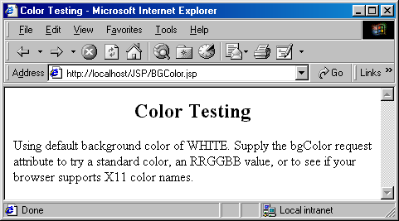
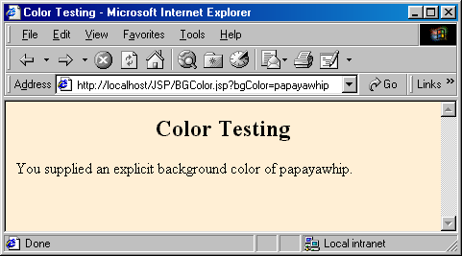
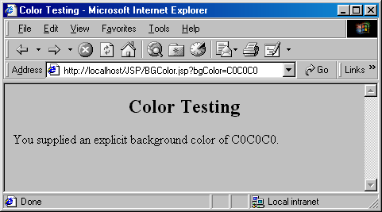
JSP Scriptlets: Results

Slide 35
Using Scriptlets to Make Parts of the JSP File Conditional
Point
  Scriplets are inserted into servlet exactly as written
  Need not be complete Java expressions
  Complete expressions are usually clearer and easier to maintain, however
Example
  <% if (Math.random() < 0.5) { %>
  Have a <B>nice</B> day!
  <% } else { %>
  Have a <B>lousy</B> day!
  <% } %>
Representative result
  if (Math.random() < 0.5) {
  out.println("Have a <B>nice</B> day!");
  } else {
  out.println("Have a <B>lousy</B> day!");
  }

Slide 36
JSP Declarations
Format
  <%! Java Code %>
Result
  Code is inserted verbatim into servlet's class definition, outside of any existing methods
Examples
  <%! private int someField = 5; %>
  <%! private void someMethod(...) {...} %>
Design consideration
  Fields are clearly useful. For methods, it is usually better to define the method in a separate Java class.
XML-compatible syntax
  <jsp:declaration>Java Code</jsp:declaration>
Notes:
Verbatim: exactly same

Slide 37
JSP/Servlet Correspondence
Original JSP
<H1>Some Heading</H1>
<%!
private String randomHeading() {
return("<H2>" + Math.random() + "</H2>");
}
%>
<%= randomHeading() %>
(Alternative: make randomHeading a static method in a separate Java class)

Slide 38
JSP/Servlet Correspondence
Possible resulting servlet code
public class xxxx implements HttpJspPage {
private String randomHeading() {
return("<H2>" + Math.random() + "</H2>");
}
public void _jspService(HttpServletRequest request,
HttpServletResponse response)
throws ServletException, IOException {
response.setContentType("text/html");
HttpSession session = request.getSession(true);
JspWriter out = response.getWriter();
out.println("<H1>Some Heading</H1>");
out.println(randomHeading());
...
} ...
}

Slide 39
Example Using
JSP Declarations
<!DOCTYPE HTML PUBLIC
"-//W3C//DTD HTML 4.0 Transitional//EN">
<HTML><HEAD><TITLE>JSP Declarations</TITLE>
<LINK REL=STYLESHEET
HREF="JSP-Styles.css"
TYPE="text/css">
</HEAD>
<BODY>
<H1>JSP Declarations</H1>
<%! private int accessCount = 0; %>
<H2>Accesses to page since server reboot:
<%= ++accessCount %></H2>
</BODY>
</HTML>

Slide 40
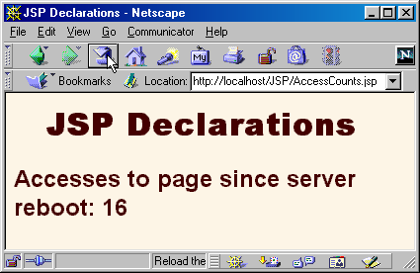
JSP Declarations: Result
After 15 total visits by an arbitrary number of different clients

Slide 41
JSP Declarations: the jspInit and jspDestroy Methods
JSP pages, like regular servlets, sometimes want to use init and destroy
Problem: the servlet that gets built from the JSP page might already use init and destroy
  Overriding them would cause problems.
  Thus, it is illegal to use JSP declarations to declare
  init or destroy.
Solution: use jspInit and jspDestroy.
  The auto-generated servlet is guaranteed to call these methods from init and destroy, but the standard versions of jspInit and jspDestroy are empty (placeholders for you to override).

Slide 42
JSP Declarations and Predefined Variables
Problem
  The predefined variables (request, response, out, session, etc.) are local to the _jspService method. Thus, they are not available to methods defined by JSP declarations or to methods in helper classes. What can you do about this?
Solution: pass them as arguments. E.g.
<%!
private void someMethod(HttpSession s) {
doSomethingWith(s);
}
%>
<% someMethod(session); %>
Note that the println method of JspWriter throws IOException
  Use “throws IOException” for methods that use println

Slide 43
Using JSP Expressions as Attribute Values
Static Value
  <jsp:setProperty
  name="author"
  property="firstName"
  value="Marty" />
Dynamic Value
  <jsp:setProperty
  name="user"
  property="id"
  value=’<%= "UserID" + Math.random() %>’ />

Slide 44
Attributes That Permit
JSP Expressions
The name and value properties of jsp:setProperty
  See upcoming section on beans
The page attribute of jsp:include
  See upcoming section on including files and applets
The page attribute of jsp:forward
  See upcoming section on integrating servlets and JSP
The value attribute of jsp:param
  See upcoming section on including files and applets

Slide 45
Summary
JSP Expressions
  Format: <%= expression %>
  Wrapped in out.print and inserted into _jspService
JSP Scriptlets
  Format: <% code %>
  Inserted verbatim into the servlet’s _jspService method
JSP Declarations
  Format: <%! code %>
  Inserted verbatim into the body of the servlet class
Predefined variables
  request, response, out, session, application
Limit the Java code that is directly in page
  Use helper classes, beans, custom tags, servlet/JSP combo

Slide 46
Agenda - Controlling the Structure of Generated Servlets
The import attribute
The contentType attribute
Generating plain text and Excel documents
The isThreadSafe attribute
The session attribute
The buffer attribute
The extends attribute
The errorPage attribute
The isErrorPage attribute

Slide 47
Purpose of the page Directive
Give high-level information about the servlet that will result from the JSP page
Can control
  Which classes are imported
  What class the servlet extends
  What MIME type is generated
  How multithreading is handled
  If the servlet participates in sessions
  The size and behavior of the output buffer
  What page handles unexpected errors

Slide 48
The import Attribute
Format
  <%@ page import="package.class" %>
  <%@ page import="package.class1,...,package.classN" %>
Purpose
  Generate import statements at top of servlet definition
Notes
  Although JSP pages can be almost anywhere on server, classes used by JSP pages must be in normal servlet dirs
  For Tomcat, this is
  install_dir\webapps\ROOT\WEB-INF\classes or
  ...\ROOT\WEB-INF\classes\directoryMatchingPackage
    Always use packages for utilities that will be used by JSP!

Slide 49
Example of import Attribute
...
<BODY>
<H2>The import Attribute</H2>
<%-- JSP page directive --%>
<%@ page import="java.util.*,coreservlets.*" %>
<%-- JSP Declaration --%>
<%!
private String randomID() {
int num = (int)(Math.random()*10000000.0);
return("id" + num);
}
private final String NO_VALUE = "<I>No Value</I>";
%>

Slide 50
Example of import Attribute (cont)
<%-- JSP Scriptlet --%>
<%
Cookie[] cookies = request.getCookies();
String oldID =
ServletUtilities.getCookieValue(cookies, "userID", NO_VALUE);
String newID;
if (oldID.equals(NO_VALUE)) {
newID = randomID();
} else {
newID = oldID;
}
LongLivedCookie cookie = new LongLivedCookie("userID", newID);
response.addCookie(cookie);
%>
<%-- JSP Expressions --%>
This page was accessed at <%= new Date() %> with a userID
cookie of <%= oldID %>.
</BODY></HTML>

Slide 51
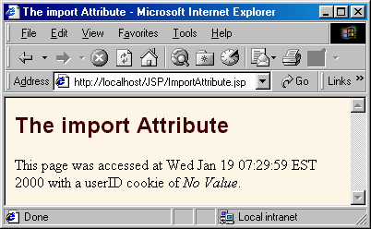

Example of import Attribute: Result
First access
Subsequent
accesses

Slide 52
The contentType Attribute
Format
  <%@ page contentType="MIME-Type" %>
  <%@ page contentType="MIME-Type;
  charset=Character-Set" %>
Purpose
  Specify the MIME type of the page generated by the servlet that results from the JSP page
Notes
  Attribute value cannot be computed at request time
  See section on response headers for table of the most common MIME types
Notes:
Multipurposes Internet Mail Extension

Slide 53
Using contentType to Generate Plain Text Documents
<!DOCTYPE HTML PUBLIC
"-//W3C//DTD HTML 4.0 Transitional//EN">
<HTML>
<HEAD>
<TITLE>The contentType Attribute</TITLE>
</HEAD>
<BODY>
<H2>The contentType Attribute</H2>
<%@ page contentType="text/plain" %>
This should be rendered as plain text,
<B>not</B> as HTML.
</BODY>
</HTML>

Slide 54
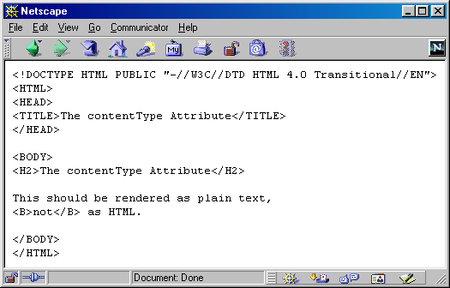
Plain Text Documents in Netscape (Correct)

Slide 55
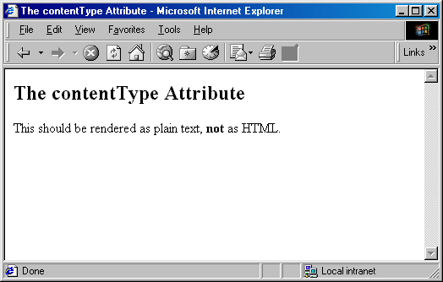
Plain Text Documents in Internet Explorer (Incorrect)

Slide 56
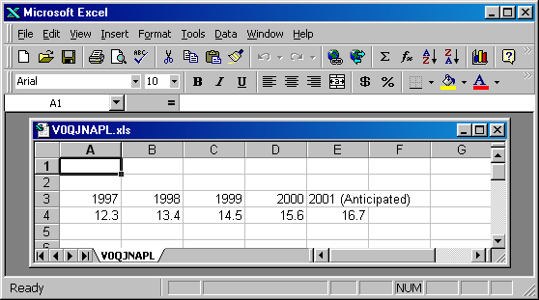
Generating Excel Spreadsheets
<%@ page contentType="application/vnd.ms-excel" %>
<%-- Note that there are tabs,
not spaces, between columns. --%>
1997 1998 1999 2000 2001 (Anticipated)
12.3 13.4 14.5 15.6 16.7

Slide 57
Generating Excel Spreadsheets Conditionally
Excel can interpret HTML tables
  Change MIME type based on request parameters
You cannot use page directive
  It does not use request-time values.
Solution
  Use predefined request variable and call setContentType
  <%
  if (someCondition) {
  response.setContentType("type1");
  } else {
  response.setContentType("type2");
  }
  %>

Slide 58
Generating Excel Spreadsheets Conditionally
<%
String format = request.getParameter("format");
if ((format != null) && (format.equals("excel"))) {
response.setContentType("application/vnd.ms-excel");
}
%>
<!DOCTYPE ...>
<HTML><HEAD>
<TITLE>Comparing Apples and Oranges</TITLE>
<LINK REL=STYLESHEET
HREF="JSP-Styles.css"
TYPE="text/css">
</HEAD>
<BODY>
<CENTER>
<H2>Comparing Apples and Oranges</H2>

Slide 59
Generating Excel Spreadsheets Conditionally (Continued)
<TABLE BORDER=1>
<TR><TH></TH><TH>Apples<TH>Oranges
<TR><TH>First Quarter<TD>2307<TD>4706
<TR><TH>Second Quarter<TD>2982<TD>5104
<TR><TH>Third Quarter<TD>3011<TD>5220
<TR><TH>Fourth Quarter<TD>3055<TD>5287
</TABLE>
</CENTER>
</BODY>
</HTML>

Slide 60
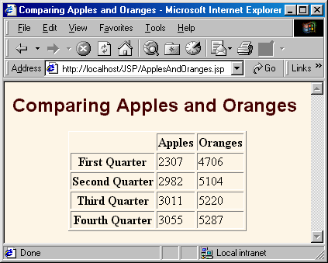
Apples and Oranges:
Default Result

Slide 61
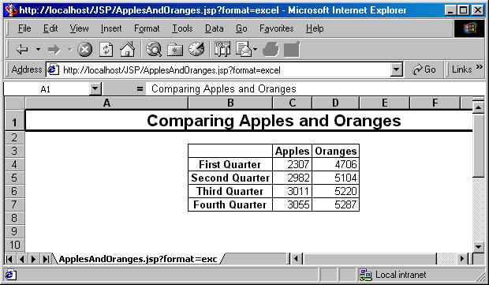
Apples and Oranges: Result with format=excel

Slide 62
The isThreadSafe Attribute
Format
  <%@ page isThreadSafe="true" %> <%-- Default --%>
  <%@ page isThreadSafe="false" %>
Purpose
  To tell the system when your code is not threadsafe, so that the system can prevent concurrent access
Notes
  Default is true -- system assumes you have synchronized updates to fields and other shared data
  Supplying a value of false can degrade performance
  Systems are permitted to make multiple instances of the servlet class as long as each is called serially.
  Moral: static fields are not necessarily safe

Slide 63
Example of Non-Threadsafe Code (IDs Must Be Unique)
What's wrong with this code?
  <%! private int idNum = 0; %>
  <%
  String userID = "userID" + idNum;
  out.println("Your ID is " + userID + ".");
  idNum = idNum + 1;
  %>

Slide 64
Is isThreadSafe Needed Here?
No
  <%! private int idNum = 0; %>
  <%
  synchronized(this) {
  String userID = "userID" + idNum;
  out.println("Your ID is " + userID + ".");
  idNum = idNum + 1;
  }
  %>
Totally safe, better performance in high-traffic environments
isThreadSafe= "false" deprecated in JSP 2.0 anyhow

Slide 65
The session Attribute
Format
  <%@ page session="true" %> <%-- Default --%>
  <%@ page session="false" %>
Purpose
  To designate that page not be part of a session
Notes
  By default, it is part of a session
  Saves memory on server if you have a high-traffic site
  All related pages have to do this for it to be useful

Slide 66
The buffer Attribute
Format
  <%@ page buffer="sizekb" %>
  <%@ page buffer="none" %>
Purpose
  To give the size of the buffer used by the out variable
Notes
  Buffering lets you set HTTP headers even after some page content has been generated (as long as buffer has not filled up or been explicitly flushed)
  Servers are allowed to use a larger size than you ask for, but not a smaller size
  Default is system-specific, but must be at least 8kb

Slide 67
The extends Attribute
Format
  <%@ page extends="package.class" %>
Purpose
  To specify parent class of servlet that
  will result from JSP page
Notes
  Use with extreme caution
  Can prevent system from using high-performance custom superclasses
  Real purpose is to let you extend classes that come from the server vendor (e.g., to support personalization features), not to extend your own classes.

Slide 68
The errorPage Attribute
Format
  <%@ page errorPage="Relative URL" %>
Purpose
  Specifies a JSP page that should process any exceptions thrown but not caught in the current page
Notes
  The exception thrown will be automatically available to the designated error page by means of the "exception" variable
  The web.xml file lets you specify application-wide error pages that apply whenever certain exceptions or certain HTTP status codes result.
    The errorPage attribute is for page-specific error pages

Slide 69
The isErrorPage Attribute
Format
  <%@ page isErrorPage="true" %>
  <%@ page isErrorPage="false" %> <%-- Default --%>
Purpose
  Indicates whether or not the current page can act as the error page for another JSP page
Notes
  Use this for emergency backup only; explicitly handle as many exceptions as possible
  Don't forget to always check query data for missing or malformed values
  The web.xml file can designate general error pages rather than page-specific ones like this

Slide 70
Error Pages: Example
(ComputeSpeed.jsp)
...
<BODY>
<%@ page errorPage="SpeedErrors.jsp" %>
<TABLE BORDER=5 ALIGN="CENTER">
<TR><TH CLASS="TITLE">
Computing Speed
</TABLE>
<%!
// Note lack of try/catch for NumberFormatException
private double toDouble(String value) {
return(Double.valueOf(value).doubleValue());
}
%>

Slide 71
Error Pages: Example
(ComputeSpeed.jsp Cont.)
<%
double furlongs = toDouble(request.getParameter("furlongs"));
double fortnights = toDouble(request.getParameter("fortnights"));
double speed = furlongs/fortnights;
%>
<UL>
<LI>Distance: <%= furlongs %> furlongs.
<LI>Time: <%= fortnights %> fortnights.
<LI>Speed: <%= speed %> furlongs per fortnight.
</UL>
...

Slide 72
Error Pages: Example
(SpeedErrors.jsp)
...
<BODY>
<%@ page isErrorPage="true" %>
<TABLE BORDER=5 ALIGN="CENTER">
<TR><TH CLASS="TITLE">
Error Computing Speed</TABLE>
<P>
ComputeSpeed.jsp reported the following error:
<I><%= exception %></I>. This problem occurred in the
following place:
<PRE>
<% exception.printStackTrace(
new java.io.PrintWriter(out)); %>
</PRE>
...

Slide 73
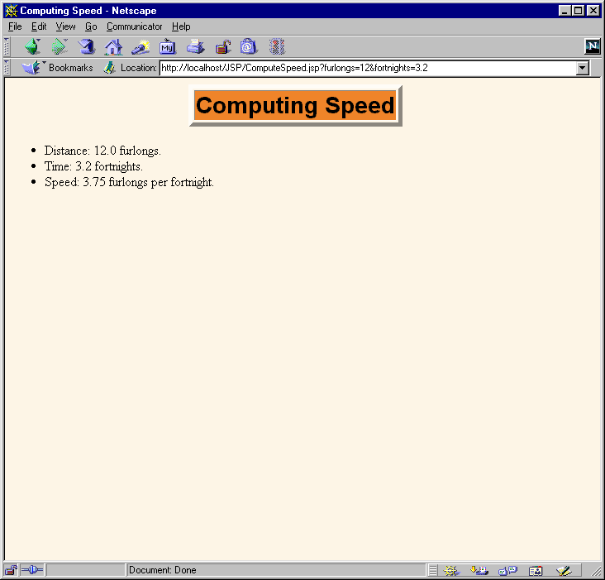
Error Pages: Example

Slide 74
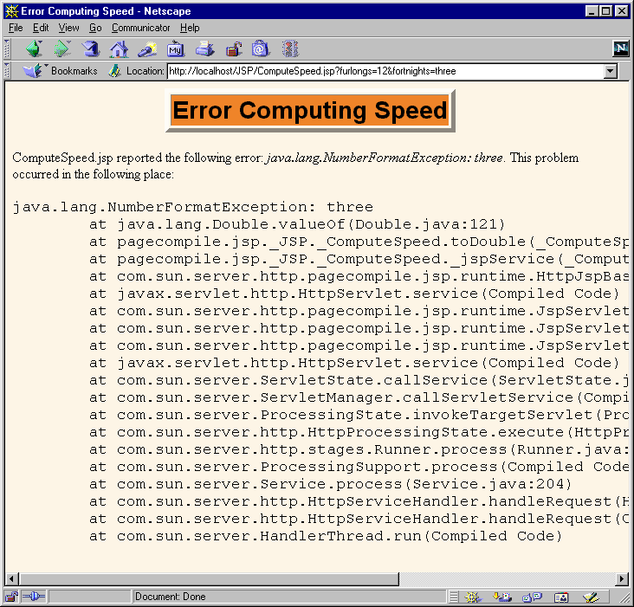
Error Pages: Example

Slide 75
Summary
The import attribute
  Changes the packages imported by the servlet that results from the JSP page
    Always use packages for utility classes!
The contentType attribute
  Specifies MIME type of result
  Cannot be used conditionally
    Use <% response.setContentType(...); %> instead
The isThreadSafe attribute
  Turns off concurrent access
  Use explicit synchronization instead
The errorPage and isErrorPage attributes
  Specifies "emergency" error handling pages

